Slide 1
Project 4:
List of Common Operating Systems
Notes:
Project 1--- Google OS, 2012-1-17, lives online\
Android is for smart cloud user interface: phone
Chrome OS change the other operating systems. Sandboxing applications can make the operating system.
more secure, saving your settings and files online ;
powerful enough to replace some of the native apps, apps will eventually migrate to the Web
more advanced features, more free storage
Project 2– IBM OS, 2012-1-25,
Short Demo on remote procedure call of OS, explained by a ROBOT.
It is intuitive/interesting and funny;
IBM Cloud computing---
Real-time analysis from IBM allow businesses to Predict and respond to a situation in an instant.
Smarter analysis means more Accurate predictions and faster reactions.

Slide 2
Project 1: Google OS, 2012-1-17
Lives online: Android and Chrome
Android is for smart cloud user interface: phone
Chrome OS changes the other operating systems
  more secure, saving your settings and files online
  powerful enough to replace some of the native apps
  apps will eventually migrate to the Web
  more advanced features, more free storage

Slide 3
Project 2: IBM OS, 2012-1-25
IBM Cloud computing
  Real-time analysis from IBM allow businesses to Predict and respond to a situation in an instant
  Smarter analysis means more Accurate predictions and faster reactions
Short Demo on remote procedure call of OS,
explained by a ROBOT.
It is intuitive/interesting and funny;

Slide 4
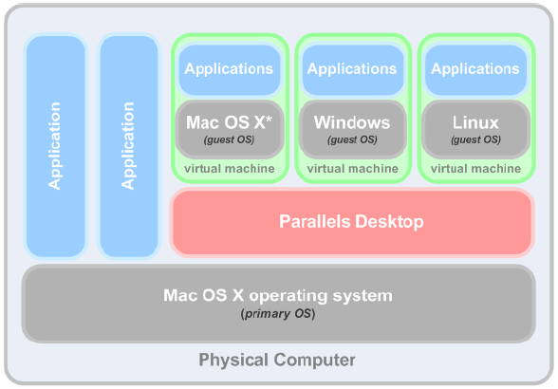
Process structure
Parallels Desktop is a virtualization solution,
allows you to create virtual machines on Mac.
Notes:
(Guest OS). An operating system installed inside your virtual machine. It can be Windows, Linux, Mac OS X, or any other supported operating system.
(Primary OS). The operating system that is loaded when you turn on your Mac – Mac OS X.
Virtual Machine (VM). A computer emulated inside your Mac. A virtual machine has its own virtual hardware and requires an operating system. The installed operating system and its applications are isolated within the virtual machine and share physical hardware resources with your Mac.

Slide 5
Parallels Desktop Function
use 32-bit and 64-bit OS inside your virtual machines
use Windows and Linux applications side by side with your Mac OS X applications, without restarting your Mac
concurrently work with the files and applications from your Mac and your virtual machine
create Parallels virtual machines from physical computers and third-party virtual machines

Slide 6
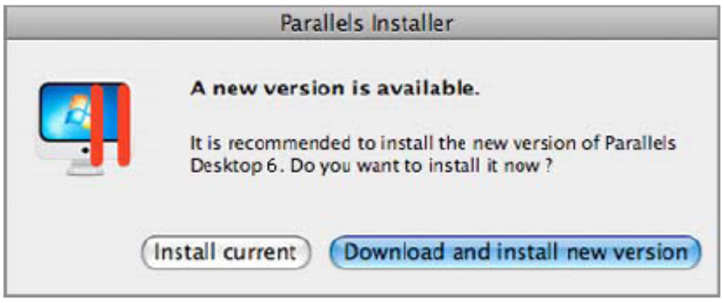
Installing Parallels Desktop
If you purchased Parallels Desktop from online store
  open the Parallels Desktop DMG package file
  double-click Install To start the installation
purchased a boxed copy of Parallels Desktop
  insert Parallels Desktop installation disk into optical drive
  open…, double-click Install To start the installation

Slide 7
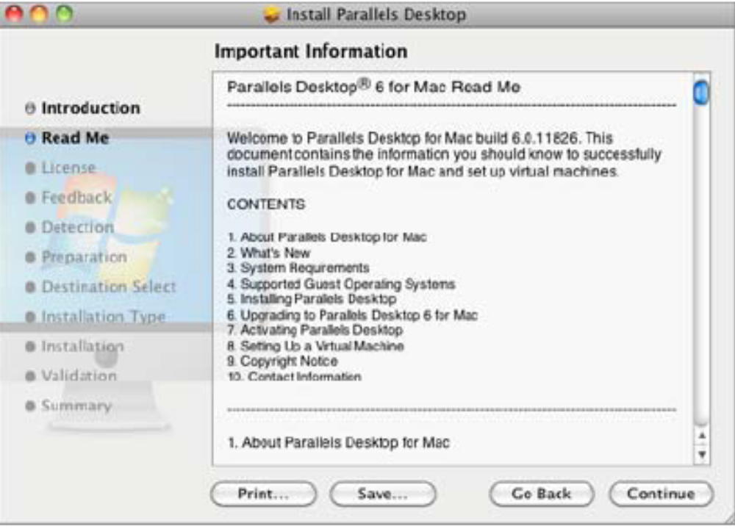
Installing Parallels Desktop
In the Welcome window, click Continue.
In the Important Information window, read the product Read Me file. Click Print to print the document or Save to save it for future reading. When finished, click Continue.

Slide 8
Installing Parallels Desktop
In Software License Agreement window, carefully read license agreement. We recommend to print/save the license agreement for your records using the Print/ Save button.
When you are ready, click Continue.

Slide 9
Installing Parallels Desktop
In Select a Destination window,
select the hard disk you would like to install Parallels Desktop. You can install Parallels Desktop only on the boot volume, that is the hard disk where Mac OS X is installed. Other disks, if any, will be unavailable for selection. Click Continue
Click Install to start the Parallels Desktop installation.
Enter your password when prompted and click OK
The installation progress is shown in the Installing Parallels Desktop window
The Installer informs you that the installation was successful, click Close

Slide 10
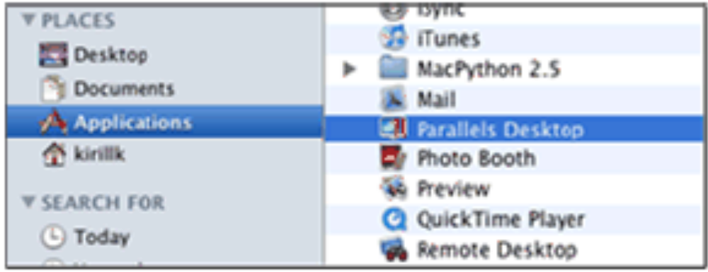
Starting Parallels Desktop
To start Parallels Desktop,
open the Applications folder in Finder and double-click Parallels Desktop.
To add the Parallels Desktop icon to the Dock,
Open the Applications folder in Finder and drag Parallels Desktop to Dock
When open the program for first time, will see the Welcome window

Slide 11
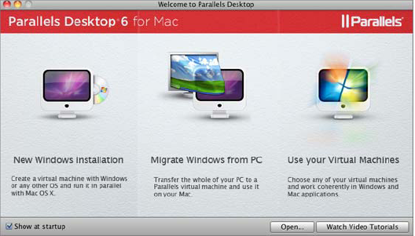
Welcome window
Notes:
New Windows Installation. This option allows you to launch New Virtual Machine Assistant to create a virtual machine with a Windows, Linux, or Mac OS X operating system.
Migrate Windows from PC. This option allows you to transfer the whole of a physical Windows or Linux computer to a Parallels virtual machine running on your Mac. The source computer data will be transferred using Parallels Transporter. To learn more about this utility, refer to Parallels Transporter User's Guide.
Use your Virtual Machines. If you have any virtual machines registered in Parallels Desktop, this option opens the Parallels Virtual Machines list (p. 26) with these virtual machines. If you have no virtual machines registered in Parallels Desktop, this option launches New Virtual Machine Assistant.

Slide 12
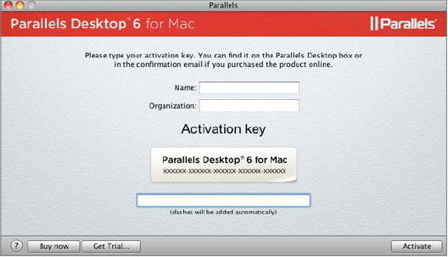
Activating Parallels Desktop
Choose Activate Product from Parallels Desktop menu.
In the activation dialog, type your product activation key into the Activation Key field and click Activate to activate your copy.

Slide 13
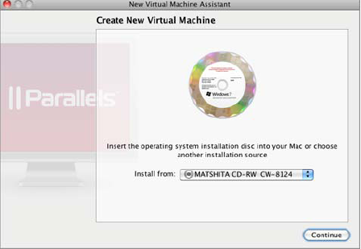
Adding Virtual Machines
Open Parallels Desktop and click New Windows Installation in the Welcome window.
Insert the operating system installation disc or connect the installation source to your Mac. In the Create New Virtual Machine window specify the source of the installation files and click Continue.
Notes:
an operating system installation CD or DVD disc ;
an image of such an installation disc ;
or a Boot Camp partition ;

Slide 14
Adding Virtual Machines
create a Windows/Linux virtual machine, you may be offered to use Express Installation, which is available for most of the popular Windows and Linux
  for Windows: the Windows product key.
  for Linux: a user name and password.

Slide 15
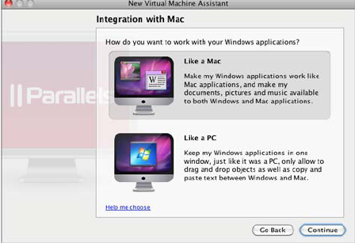
Adding Windows Virtual Machines
choose one of the following ways of working
  Like a Mac: You will be able to work in both Windows and Mac applications on the single Mac OS Desktop, and your Mac desktop, as well as the documents, pictures, music, videos and downloads folders will be shared with Windows.
  Like a PC: your Windows will run in a separate window and your Mac files will not be shared with Windows, but you will be able to drag and drop files between the systems, as well as copy text.

Slide 16
Adding Windows Virtual Machines
review your virtual machine name and location.
  If you want other users of your Mac to access your virtual machine, choose Share with other users of this Mac - and your virtual machine will be saved in the /Users/Shared folder that is accessible to all users.
  If you want to edit your virtual machine hardware configuration before proceeding to OS installation, select Customize settings before installation.
When finished, click Create.
Parallels Desktop creates an administrator account with a blank password for new virtual system. When the guest OS installation is complete, it is recommended that you change this password.

Slide 17
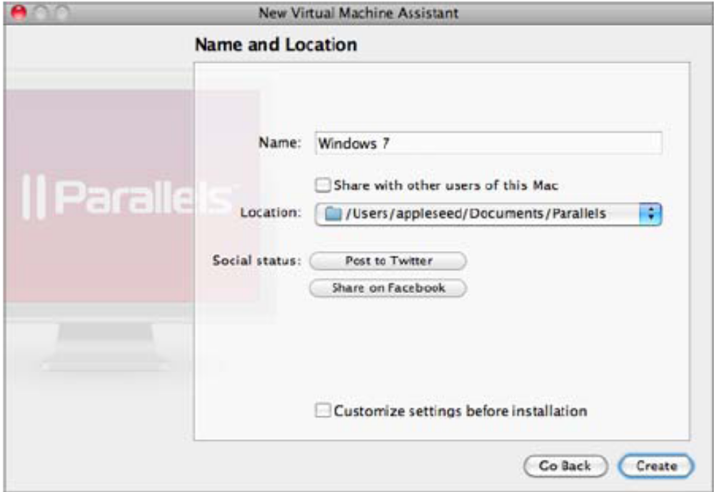
Adding Windows Virtual Machines

